Slide 1
CSC 362: System Programming
Lecture 18
Original slides by: Amitabha Dey
Adapted by: Dr. Richard Johnson
Department of Computer Science University of North Carolina at Greensboro

Slide 2

Status Check
Threads vs Processes
Multi-threaded Programs in C
pthread_create, pthread_join, pthread_exit, pthread_cancel
What we will cover today
Race Conditions
Critical Sections
Atomic Operations
Thread Synchronization
Mutual Exclusion: Mutexes
Thread Safety and Basic Thread-Safe Programming

Slide 3


Understanding Race Condition
1
Let’s imagine two programs that make use of some shared resource. Both programs is designed to increase the value in the shared resource by 1.
Notes:
Simple Shared Resource Scenario:
Illustrates two programs designed to increase a shared value by 1.
When running individually,
there is no problem as each program can read,
calculate, and replace the value correctly.

Slide 4
Understanding Race Condition
1
1
If one program is trying to increase the value by 1, there is no problem. The program can see what the value is, calculate the value 1 higher, and replace the existing value.

Slide 5
Understanding Race Condition
1+1 = 2
1
If one program is trying to increase the value by 1, there is no problem. The program can see what the value is, calculate the value 1 higher, and replace the existing value.

Slide 6
Understanding Race Condition
1+1 = 2
2
If one program is trying to increase the value by 1, there is no problem. The program can see what the value is, calculate the value 1 higher, and replace the existing value.

Slide 7
Understanding Race Condition
2
A challenge computers face though is how to deal with concurrency. If both programs try to access the data at the same time, what happens?
Notes:
Concurrency Challenge:
Explains that if both programs access the same data simultaneously,
they may both read the original value and overwrite each other's work.

Slide 8
Understanding Race Condition
2
2
2
If we are unlucky, both programs will look at the original value, both will calculate the value 1 higher, and both will try to replace the original value.

Slide 9
Understanding Race Condition
2+1=3
2+1=3
2
If we are unlucky, both programs will look at the original value, both will calculate the value 1 higher, and both will try to replace the original value.

Slide 10
Understanding Race Condition
2+1=3
2+1=3
3
If we are unlucky, both programs will look at the original value, both will calculate the value 1 higher, and both will try to replace the original value.

Slide 11
Understanding Race Condition
Intent
2 → 3 → 4
Actual
2 → 3 → 3
This is an example of race condition, and we would like to avoid it if possible.
Notes:
Race Condition Illustration:
A sequence of diagrams showing two programs attempting to increment a shared resource (value 2).
Both calculate a new value of 3 simultaneously, resulting in a final value of 3 instead of the intended 4.
Intent vs. Actual Result:
Demonstrates that the intended outcome (e.g., 2 → 3 → 4)
may fail due to a race condition (e.g., 2 → 3 → 3),
also known as a "dirty read".

Slide 12
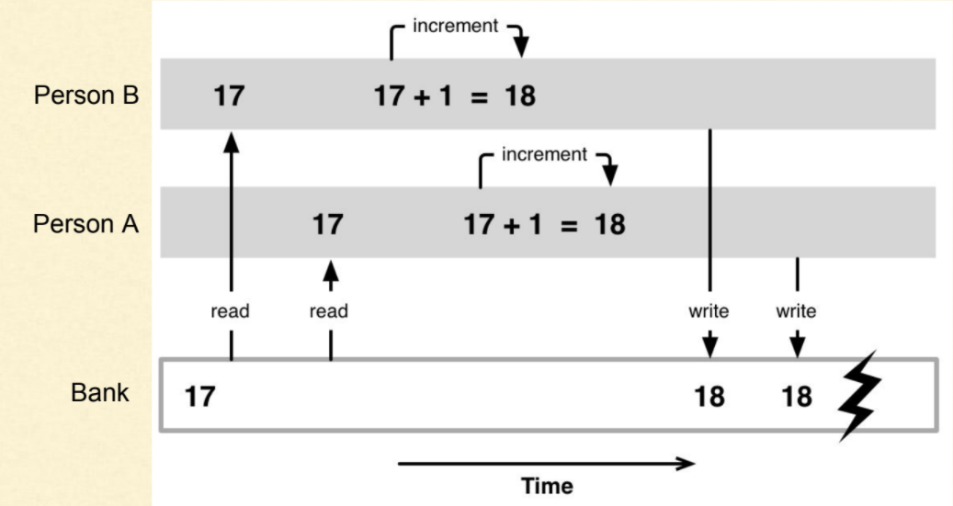
Understanding Race Condition
Two persons are trying to deposit 1 dollar online into the same bank account.
The initial amount is 17 dollar. Both the persons would be able to see $17 initially. Each of them tries to deposit $1, and the final amount is expected to be $19.
But due to race conditions, the final amount in the bank is $18 instead of $19. This is also known as dirty read.
Image credit - https://cloudxlab.com/
Notes:
Figure:
A diagram illustrating a race condition in a banking context.
Two people (Person A and Person B) simultaneously
read a balance of 17,
increment it to 18,
and write it back,
causing one update to be lost and resulting in an incorrect final balance of 18 instead of 19.

Slide 13
Understanding Race Condition
To avoid race condition, we need some mechanism to ensure only one program at a time can access one particular region of the code, a region called critical section.
3
critical section
Notes:
Critical Section Definition:
A part of code where shared resources are accessed.
To avoid race conditions, only one thread should execute here at a time .

Slide 14
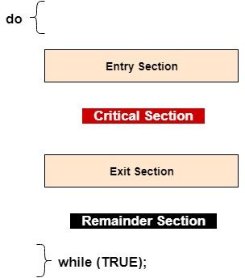
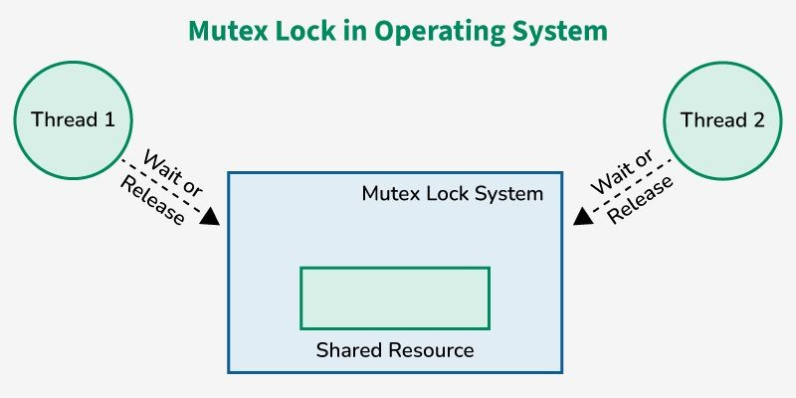
Understanding Race Condition Critical Section
A critical section is a part of the code where shared resources are accessed or modified. Only one thread should execute a critical section at any time to avoid race conditions.
Image credit - https://www.geeksforgeeks.org/
Image credit - https://www.ques10.com/

Slide 15
Understanding Race Condition
One simple strategy is to force our programs to take turns. We can add a value (turn indicator) to our setup responsible for keeping track whose turn it is.
3
critical section
Notes:
Strategy 1: Taking Turns:
Uses a "turn indicator" to let only one program enter the critical section at once.
However, this causes unnecessary waiting if one program needs access more often than the other.
Turn Indicator Strategy:
A diagram where a "turn indicator" points to one program,
allowing only that specific program to enter the critical section to update the value from 3 to 4.

Slide 16
Understanding Race Condition
The turn indicator starts by pointing to one program, and only that program is allowed to enter the critical section.
3+1=4
3
critical section

Slide 17
Understanding Race Condition
The turn indicator starts by pointing to one program, and only that program is allowed to enter the critical section.
3+1=4
4
critical section

Slide 18
Understanding Race Condition
When the program leaves the critical section, they can flip the indicator the other way, and let it be the other program’s turn.
4
critical section

Slide 19
Understanding Race Condition
This setup does ensure that only one program is inside the critical section at any given time.
4+1=5
4
critical section

Slide 20
Understanding Race Condition
This setup does ensure that only one program is inside the critical section at any given time.
4+1=5
5
critical section

Slide 21
Understanding Race Condition
However, this is not a great solution if one program needs to access the critical section much more often than the other program.
5
critical section

Slide 22

Understanding Race Condition
If one program needs to access the critical section, but it’s the other program’s turn, then we are forced to wait, even if the other program doesn’t need the critical section until later.
5
It’s not my turn so have to wait!
critical section
Notes:
Turn Indicator Conflict:
One program is shown waiting outside the critical section with the caption:
"It’s not my turn so have to wait!"
despite the other program not currently using the resource.

Slide 23
Understanding Race Condition
We can resolve the problem by first giving our program a way to signal their intent of entering the critical section.
Planning to enter
5
critical section
Notes:
Signal Light Intent:
A diagram shows a shared critical section with a value of 5.
Two programs each have a "signal light" toggled on, displaying the text "Planning to enter“

Slide 24


Understanding Race Condition
Each program will be given a signal light, that can be toggled on or of. Any time a program wants to enter the critical section, they will toggle it on to indicate their intent.
5
critical section
Notes:
Strategy 2: Signal Lights:
Programs use signals to show intent to enter.
A program cannot enter if the other's light is on.
This can lead to a deadlock where both programs wait forever for each other's light to turn off.

Slide 25
Understanding Race Condition
Must obey the rule: A program can never enter the critical section, if the other program’s signal light is turned on!
5
Can’t enter, the other signal light is on.
Can’t enter, the other signal light is on.
critical section
Notes:
Initial Conflict:
Both programs are shown outside the critical section.
Each program's status reads: "Can’t enter, the other signal light is on".

Slide 26
Understanding Race Condition
If the other program’s signal light is turned off, then we know that they don’t want to enter the critical section. So, we are free to access the data regardless of where the turn pointer is indicating.
6
5+1=6
critical section

Slide 27
Understanding Race Condition
If the other program doesn’t indicate intent to enter, we know we can enter the critical section without conflict. After the program is done, it can exit the critical section, and turn off its signal light.
6
turn it off
critical section

Slide 28
Understanding Race Condition
If both program wants to enter the critical section, both program will turn on their signal lights, but no program is allowed to enter when the other program’s signal light is on.
6
Can’t enter, the other signal light is on.
Can’t enter, the other signal light is on.
critical section

Slide 29
Understanding Race Condition
Deadlocks
Both programs are now stuck in a deadlock. Both programs are left waiting forever for the other program’s light to turn off, but neither light ever turns off.
DEADLOCK!
6
Can’t enter, the other signal light is on.
Can’t enter, the other signal light is on.
critical section
Notes:
Deadlock State:
The central text "DEADLOCK!" appears.
Both programs remain stuck outside the critical section
because they are waiting for the other's signal light to turn off,
which will never happen.

Slide 30
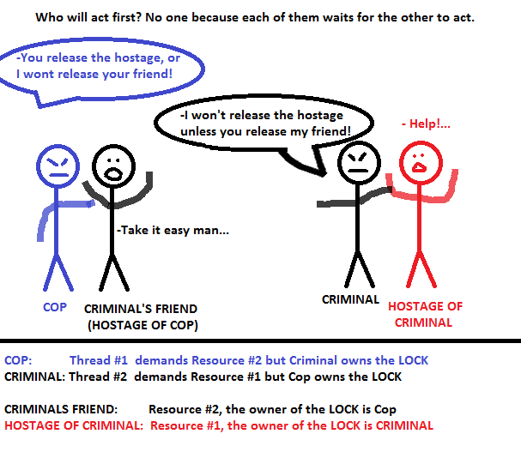
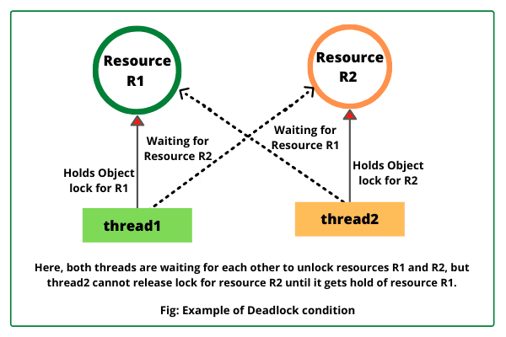
Understanding Race Condition
Deadlocks
Image credit - https://dip-mazumder.medium.com/

Slide 31
Understanding Race Condition
We can resolve the deadlock by checking the turn indicator to decide who gets to enter the critical section.
6
critical section
Notes:
Strategy 3: Resolving Deadlock:
Combines signals and turn indicators.
If both want to enter, the turn indicator decides who goes first while the other waits.

Slide 32
Understanding Race Condition
If we ever want to enter, and the other program’s signal light is on, we can check to see who’s turn it is.
6
Not my turn!
critical section

Slide 33
Understanding Race Condition
If it’s the other programs turn, we should turn off our own signal light. And wait for it to be our turn.
6
turn it off
Not my turn!
critical section
Notes:
Resolving Deadlock:
A diagram showing a program checking the turn indicator while its signal is on.
It sees it is not its turn and toggles its signal to "off" to allow the other program to proceed.

Slide 34
Understanding Race Condition
The other program meanwhile enters the critical section when it sees that the other program’s signal light is off.
6+1=7
7
I can enter since the other signal light is off.
critical section

Slide 35
Understanding Race Condition
When the other program exits, it should toggle the indicator back to us, and turn off it’s own signal light.
7
critical section

Slide 36
Understanding Race Condition
When we see the turn indicator switch, we will turn our own signal light back on, and since the other program’s signal light is turned off, we are now clear to enter the critical section ourselves.
7
turn it on
It’s my turn now!
critical section

Slide 37
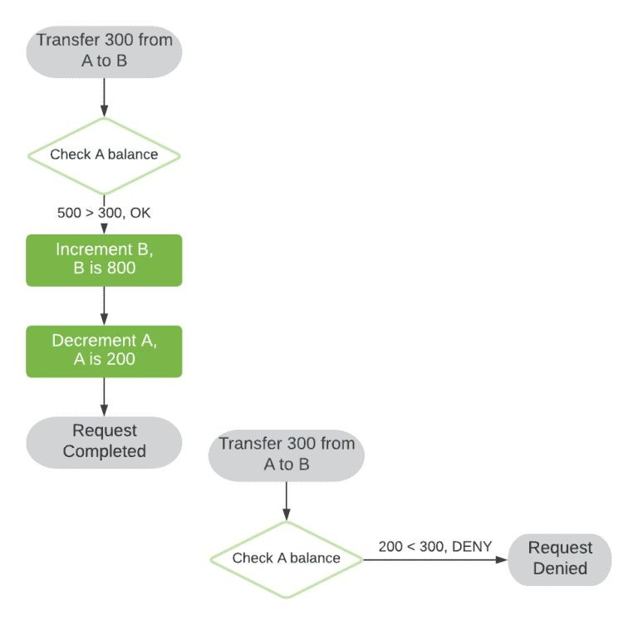
Race Conditions
A race condition occurs when two or more threads or processes access shared data at the same time, and at least one thread modifies the data. This leads to inconsistent or incorrect outcomes since the order of execution impacts the final result.
In simpler terms, it's a problem that arises when the result of an operation is dependent on the order in which concurrent threads execute.
Let’s say we are trying to transfer $300 from one account to another.
Image credit - https://www.baeldung.com/
Notes:
Race Condition Specifics:
Defines race conditions as occurring when multiple threads access shared data and at least one modifies it,
making the result dependent on execution order.

Slide 38
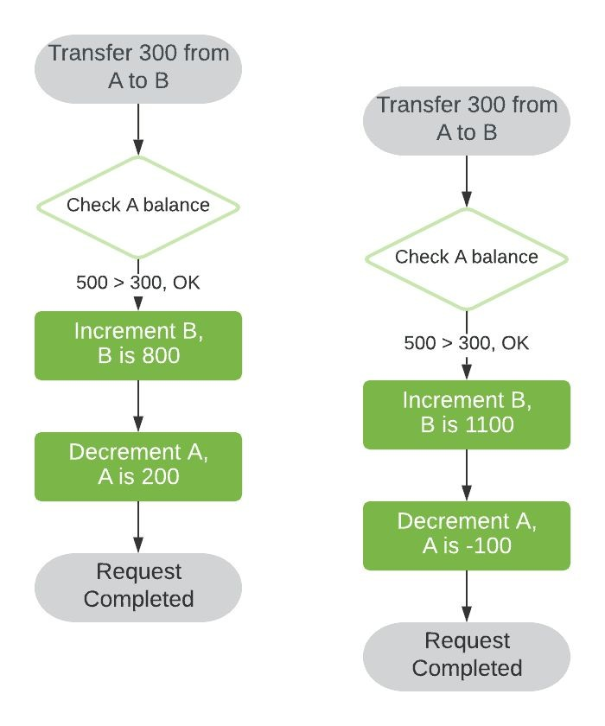
Race Conditions
However, if these two attempts are kicked off simultaneously, in different processes or threads, we may observe some undesired behavior.
We’ve encountered a race condition due to the interleaving of our execution flows.
Image credit - https://www.baeldung.com/

Slide 39
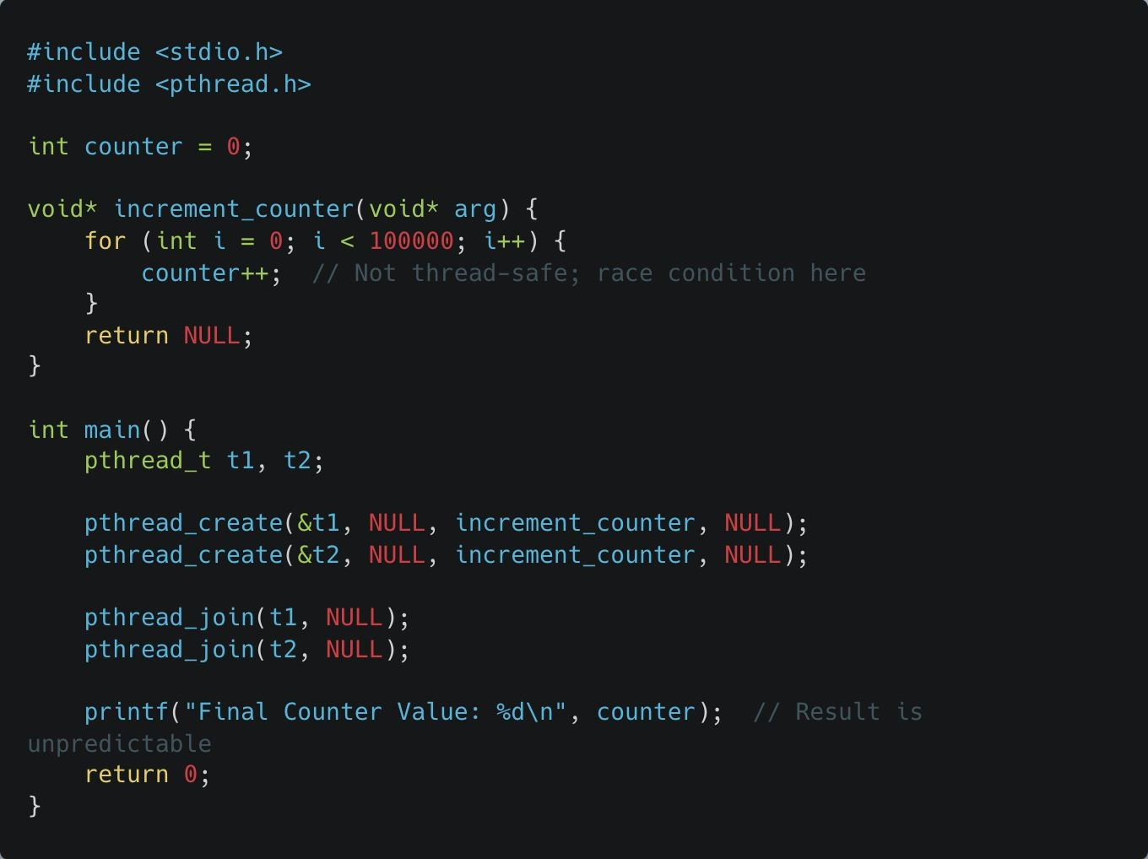
Race Conditions
Global Counter Variable:
The counter variable is declared as a global integer, accessible by all threads in the program.
Increment Function (increment_counter):
This function is designed to increment counter 100,000 times.
However, counter++ is not thread-safe. This operation involves three steps: reading the current value, incrementing it, and then storing the new value. Since threads can interrupt each other between these steps, counter can end up with an incorrect value.
Thread Creation:
In main(), two threads (t1 and t2) are created using
pthread_create(), both running increment_counter.
Each thread runs increment_counter independently, attempting to increment counter 100,000 times.
Notes:
Global Counter Example:
Shows how counter++ is not thread-safe because
it involves three separate steps (read, increment, store),
which can be interrupted.
See example:
race_condition.c

Slide 40
Race Conditions
Joining Threads:
pthread_join() is used to wait for both threads (t1 and t2) to complete before printing the final value of counter.
Race Condition:
Because both threads access counter simultaneously without any synchronization mechanism (like a mutex), they end up reading and modifying counter at unpredictable times. This leads to race conditions, making the final value of counter unpredictable.
Final Output:
The printf() statement outputs the final value of counter, which could vary with each run of the program. Ideally, if each thread incremented counter 100,000 times without interference, the final value would be 200,000. However, due to the race condition, the output will likely be less than 200,000.

Slide 41
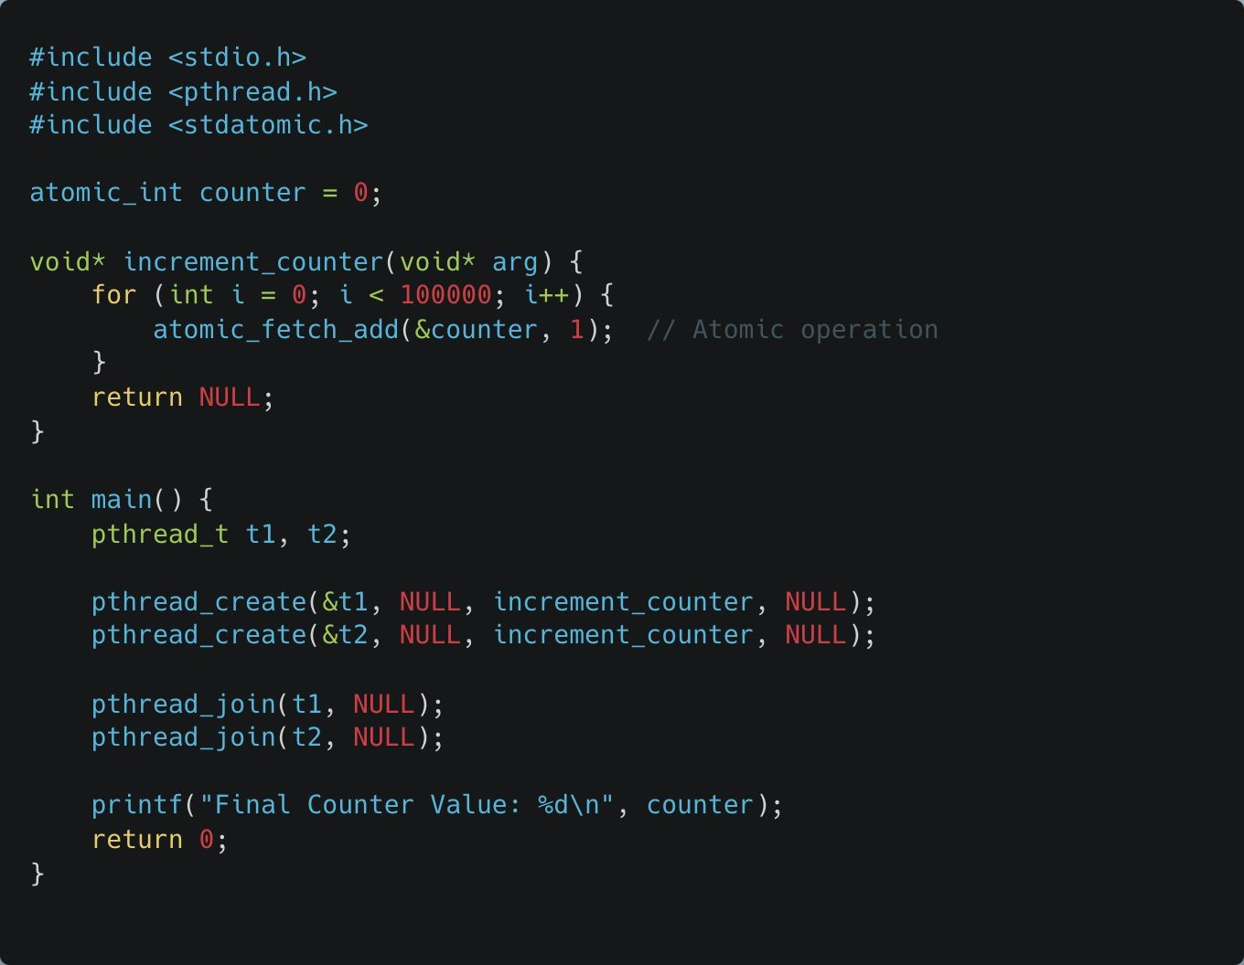
Atomic Operations
Solution: To avoid race conditions, any operation on a shared resource – that is, on a resource that can be shared between threads – must be executed atomically.
When an operation on a shared resource is executed atomically, it means that the operation is treated as a single, indivisible unit of work. This ensures that the operation is not interrupted or interleaved with operations from other threads, eliminating the possibility of race conditions.
An atomic operation is executed completely independently of any other operations and cannot be interrupted. Atomic operations are useful in preventing race conditions without requiring complex locks.
Notes:
Atomic Operations:
Solutions involving indivisible operations (using <stdatomic.h>) that cannot be interrupted,
ensuring thread safety without complex locks.
See example:
atomic_operation.c

Slide 42
Atomic Operations
Atomic Counter Variable:
Instead of a standard int, counter is declared as atomic_int, which ensures atomic (indivisible) operations on the variable.
This is provided by the <stdatomic.h> library, allowing operations on counter that cannot be interrupted by other threads.
Atomic Increment:
The increment operation in increment_counter()
now uses atomic_fetch_add(&counter, 1).
This atomic function increments counter by 1 in a thread-safe way, guaranteeing that each increment is completed without interference from other threads. This eliminates the need for a mutex to protect the counter.

Slide 43
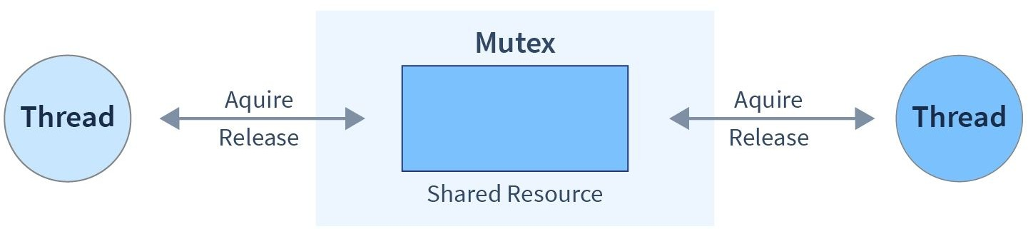
Thread Synchronization Mutual Exclusion: Mutexes
Mutexes (short for "mutual exclusion") are locks that ensure only one thread accesses a critical section at any time.
Key Features of Mutexes:
Image Credit - https://www.scaler.com/
Exclusive Access:
A mutex allows only one thread to lock it at a time. Other threads trying to lock the mutex will be blocked until the mutex is unlocked by the owning thread.
Critical Section Protection:
By locking a mutex before entering a critical section and unlocking it afterward, you prevent race conditions and ensure data consistency.
Thread Safety:
Mutexes enable safe access to shared resources (e.g., variables, file descriptors) in concurrent environments.
Blocking Behavior:
Threads attempting to acquire a locked mutex will wait (block) until it is unlocked.
Notes:
Introduction to Mutexes:
Locks that ensure exclusive access to a critical section,
blocking other threads until the lock is released.

Slide 44
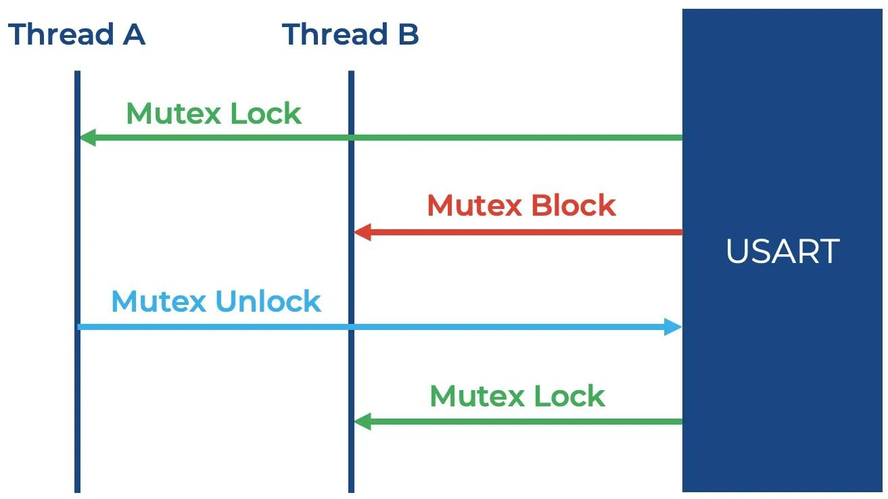
Thread Synchronization
Mutual Exclusion: Mutexes - Pthreads Library
pthread_mutex_init: Initializes a mutex.
pthread_mutex_lock: Acquires a mutex lock (blocking if already locked).
pthread_mutex_unlock: Releases a mutex lock, allowing other threads to acquire it.
pthread_mutex_destroy: Destroys a mutex and frees its resources.
Shared Resource
Image Credit - https://www.beningo.com/
Notes:
Pthreads Mutex Library:
Details functions like pthread_mutex_init, lock, unlock, and destroy to protect shared variables like global counters.
Figure:
A sequence diagram showing interaction between Thread A, Thread B, and a Shared Resource.
It illustrates Thread A acquiring a Mutex Lock, causing Thread B's subsequent lock request to result in a Mutex Block.
Once Thread A sends a Mutex Unlock, Thread B successfully acquires the lock.

Slide 45
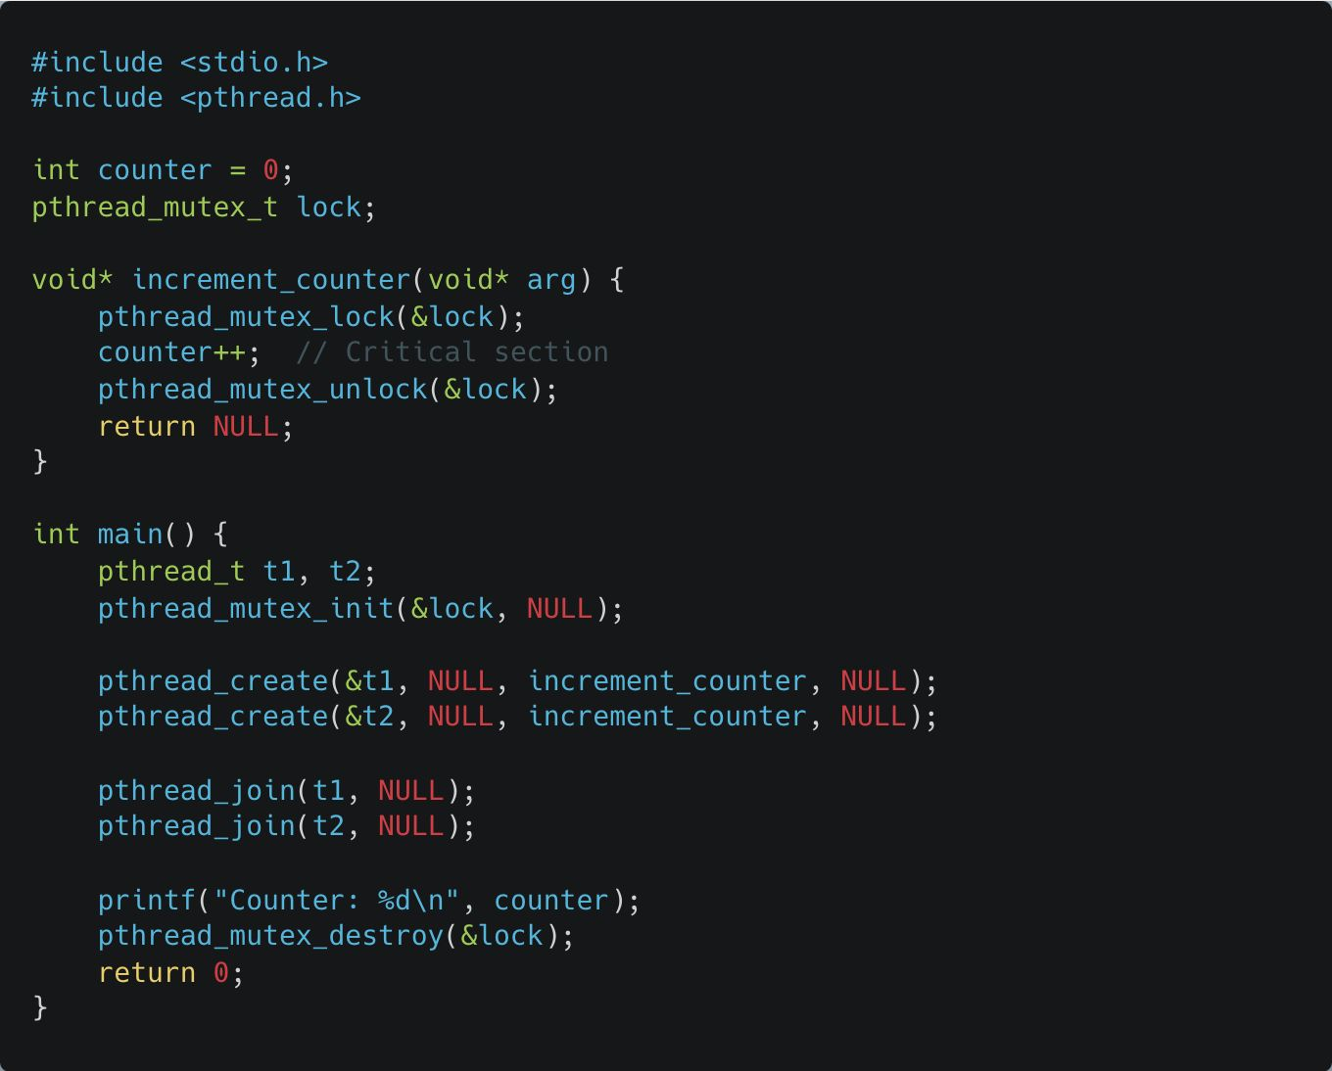
Thread Synchronization
Mutual Exclusion: Mutexes
Global Mutex (pthread_mutex_t lock):
The lock variable is a mutex used to ensure only one thread can access the counter variable at any given time, providing mutual exclusion.
Mutex Locking and Unlocking:
In the increment_counter function:
pthread_mutex_lock(&lock); locks the mutex, allowing the thread exclusive access to the counter variable.
pthread_mutex_unlock(&lock); unlocks the mutex after the critical section, allowing other threads to access counter.
These calls protect the critical section (the increment operation on counter) from concurrent access by other threads, thus preventing race conditions.
Notes:
See example:
mutex.c

Slide 46
Thread Synchronization
Mutual Exclusion: Mutexes
Thread Creation (pthread_create):
Two threads (t1 and t2) are created, each executing the increment_counter function.
Without the mutex, these threads would access counter concurrently, potentially causing incorrect results. Here, the mutex enforces thread-safe access.
Thread Joining (pthread_join):
pthread_join is used to wait for both threads (t1 and t2) to finish execution before proceeding, ensuring that the main function only prints counter after both threads complete.

Slide 47
Thread Synchronization
Mutual Exclusion: Mutexes
Mutex Initialization and Destruction:
pthread_mutex_init(&lock, NULL); initializes the mutex at the start, and pthread_mutex_destroy(&lock); releases resources at the end of the program. This setup and teardown of the mutex are essential for proper resource management.

Slide 48
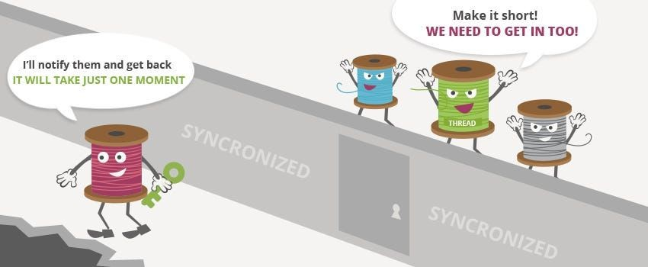
Thread Safety
Bank Account Balance Update
Thread safety refers to writing code in a way that multiple threads can execute without causing data corruption or unpredictable behavior. Thread-safe code avoids using shared resources unsafely.
This example demonstrates a bank account balance that multiple threads can either deposit into or withdraw from. By using a mutex to protect the shared balance variable, we ensure
thread-safe operations.
Image Credit - Gowthamy Vaseekaran @ Medium

Slide 49
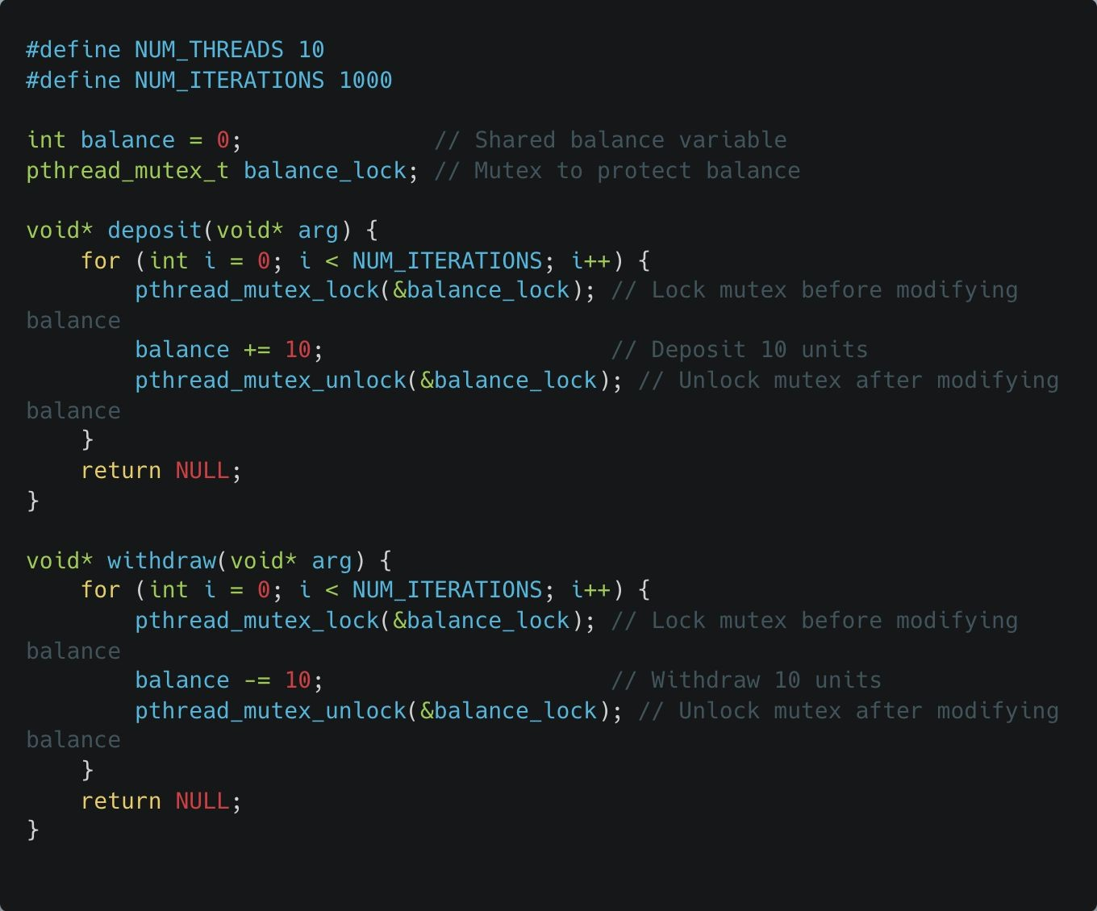
Thread Safety
Bank Account Balance Update
Shared Balance Variable:
balance is a shared variable representing the bank account balance. Both the deposit and withdraw functions modify this variable.
Mutex for Thread Safety:
pthread_mutex_t balance_lock is a mutex that ensures only one thread can modify balance at a time.
pthread_mutex_lock and pthread_mutex_unlock are used to acquire and release the mutex around the critical section where balance is modified.
Notes:
Bank Account Example:
Demonstrates thread safety by protecting a shared balance variable with a mutex during deposit() and withdraw() operations .
See example:
thread_safety.c

Slide 50
Thread Safety
Bank Account Balance Update
Deposit and Withdraw Functions:
deposit() increments the balance by 10 units in each iteration, while withdraw() decrements it by 10 units.
Both functions use the mutex to prevent race conditions by ensuring that only one thread can modify balance at any given moment.

Slide 51
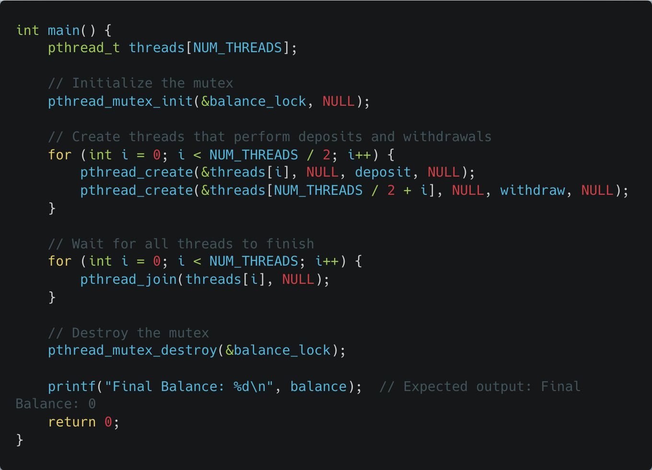
Thread Safety
Bank Account Balance Update
Mutex Initialization and Destruction:
The mutex is initialized with pthread_mutex_init and destroyed with pthread_mutex_destroy to ensure proper allocation and deallocation of resources.

Slide 52
Thread Safety
Bank Account Balance Update
Deposit and Withdraw Functions:
deposit() increments the balance by 10 units in each iteration, while withdraw() decrements it by 10 units.
Both functions use the mutex to prevent race conditions by ensuring that only one thread can modify balance at any given moment.

